Slide 1

Vel Tech Rangarajan Dr. Sagunthala R&D Institute of Science and Technology
School of Computing
Department of Computer Science and Engineering
10211CS224 / FULL STACK APPLICATION DEVELOPMENT (JAVA)
PROJECT REVIEW : MILESTONE PROJECT – 1
Date: DD-MM-YYYY
Responsive E-Commerce Interface with State-Persistent Cart
SDG:SDG 9 – Industry, Innovation and Infrastructure
Presented By:
K.Likith kumar – VTU24742– 23UECS1104
Courses Handling Faculty:
Dr.S.Hemamalini - Designation

Slide 2
INTRODUCTION
Growing demand for efficient and user-friendly e-commerce platforms.
Issues in existing systems with poor responsiveness across devices.
Loss of cart data during page refresh or session changes.
Need for improved user experience and seamless navigation.
Implementation of a responsive design for all screen sizes.
Use of state persistence to maintain cart data across sessions.
Enhances customer satisfaction and increases business sales.
Real-world application in modern online shopping systems using web technologies.
1
2
3
4
5
6
7
8
9

Slide 3
PROBLEM STATEMENT
Many e-commerce platforms do not provide a fully responsive interface across all devices.
Users face difficulty navigating websites on mobile, tablet, and desktop screens.
Shopping cart data is often lost during page refresh or browser closure.
Lack of state persistence leads to poor user experience and frustration.
Existing systems do not efficiently manage user session data.
This results in reduced customer engagement and potential loss of sales.
There is a need for a reliable system that maintains cart data consistently.
A responsive and state-persistent e-commerce solution is required to improve usability and performance.
1
2
3
4
5
6
7
8
9

Slide 4
OBJECTIVE(S)
To design and develop a responsive e-commerce interface
To implement a state-persistent shopping cart system.
To improve user experience and data retention across sessions.
To evaluate performance of the system in terms of usability and efficiency.
1
2
3
4
5
6
7
8
9

Slide 5
PROPOSED SYSTEM
Develop a responsive e-commerce interface compatible with mobile, tablet, and desktop devices.
Implement a state-persistent cart using local storage or session storage.
Ensure cart data is retained even after page refresh or browser restart.
Provide a smooth and consistent user experience across all devices.
Reduce data loss issues present in existing e-commerce systems.
Improve customer satisfaction by maintaining user selections reliably.
Increase efficiency and usability compared to traditional systems.
Offer a scalable and modern solution using current web technologies.
1
2
3
4
5
6
7
8
9

Slide 6
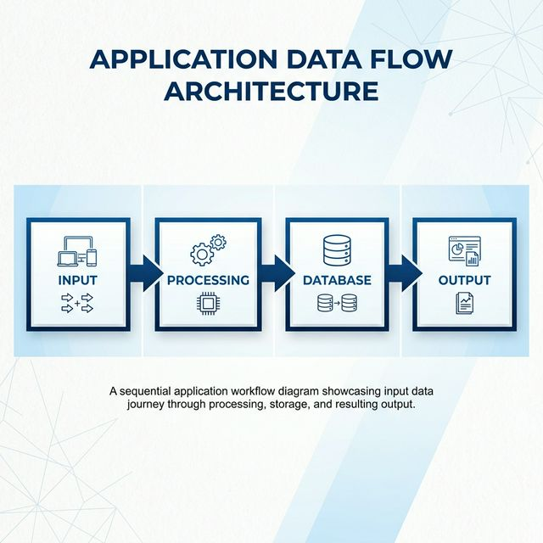
PROPOSED SYSTEM ARCHITECTURE
1
2
3
4
5
6
7
8
9

Slide 7
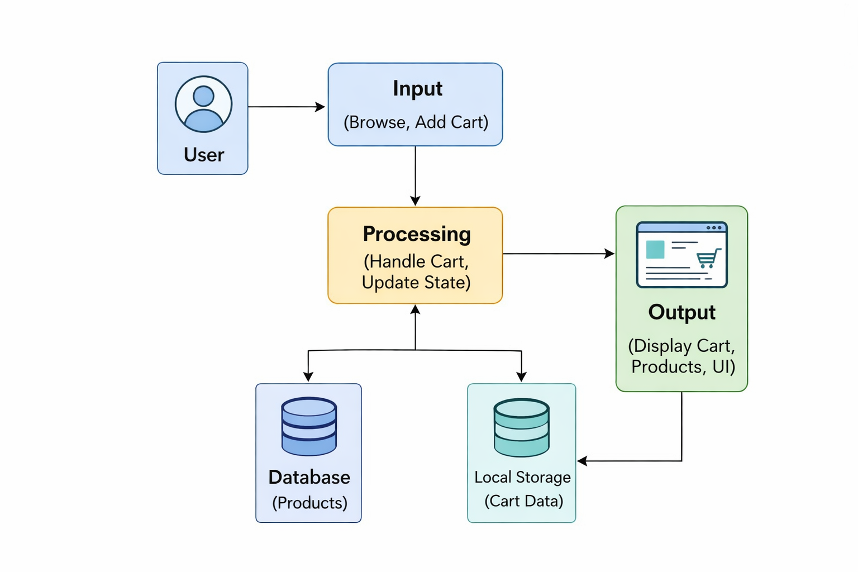
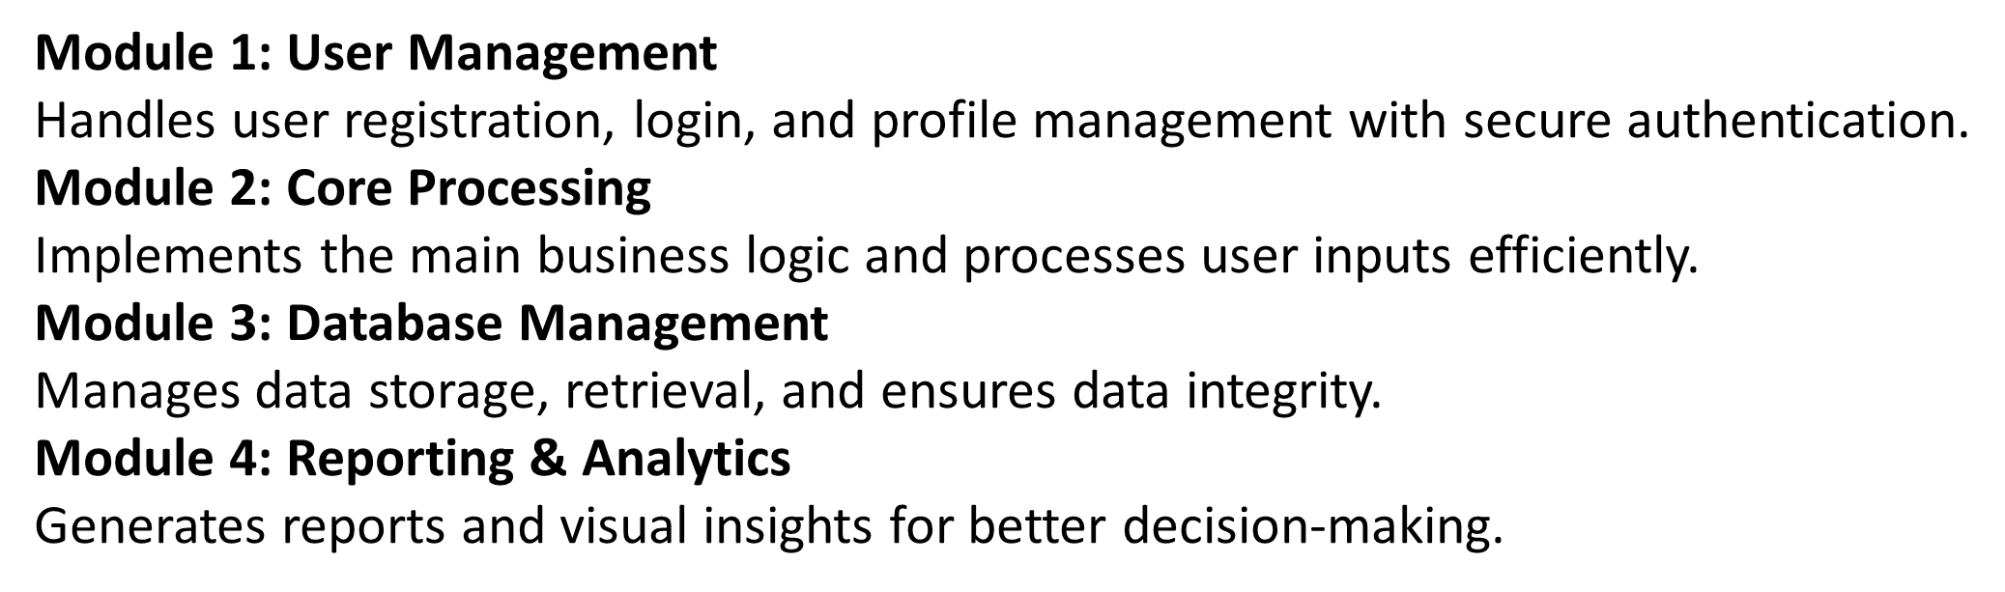
Frontend:
Backend:
Database:
Tools:
Hardware/Software Requirements:
WORKFLOW
1
2
3
4
5
6
7
8
9

Slide 8
TECHNOLOGIES USED
Frontend:HTML5, CSS3, JavaScript (Vanilla JS) (This is what creates the user interface, styling, and interactivity on the browser side like index.html and script.js)
Backend:Node.js, Express.js (This is the server-side logic in server.js that handles the API requests, routing, and business logic)
Database:MongoDB (with Mongoose) (This is the NoSQL database where you store your Users, Products, and Cart collections)
Tools:visual Studio Code (VS Code), Node Package Manager (npm), Postman (for API testing), Git (for version control) (These are the applications you use to write, test, and manage your code)
Hardware/Software Requirements: Software: Any modern web browser (Chrome, Edge, Safari), Node.js runtime environment installed on the machine, MongoDB server (local or cloud like Atlas).
Hardware (Minimum):A standard computer or laptop with at least 4GB of RAM and a basic processor (e.g., Intel i3 or equivalent) to run the development server efficiently.
1
2
3
4
5
6
7
8
9

Slide 9
MODULE DESCRIPTION
User Management
login page (login.html/login.js), verifying if a user is a Buyer or a Seller, and granting them the correct dashboard access. It ensures that only logged-in users can add items to their cart or list new products.
Core Processing
The server logic (server.js) that manages adding items to the cart, calculating total prices, updating product quantities, and dynamically rendering the product catalog on index.html. It takes the user's clicks and makes the business logic happen efficiently.
Database Management
This module ensures that when a user adds something to their cart, it is safely stored in the Cart collection so it doesn't disappear when they refresh the page. It also handles retrieving the list of products from the Products collection and keeping user data secure in the Users collection.
Reporting & Analytics
In your current project, this is primarily your Seller Dashboard (seller.html/seller.js). It allows the seller to see a "report" of all the products they have listed and track their current inventory levels. In the future, this module could easily be expanded to show them total sales or popular items!
1
2
3
4
5
6
7
8
9

Slide 10
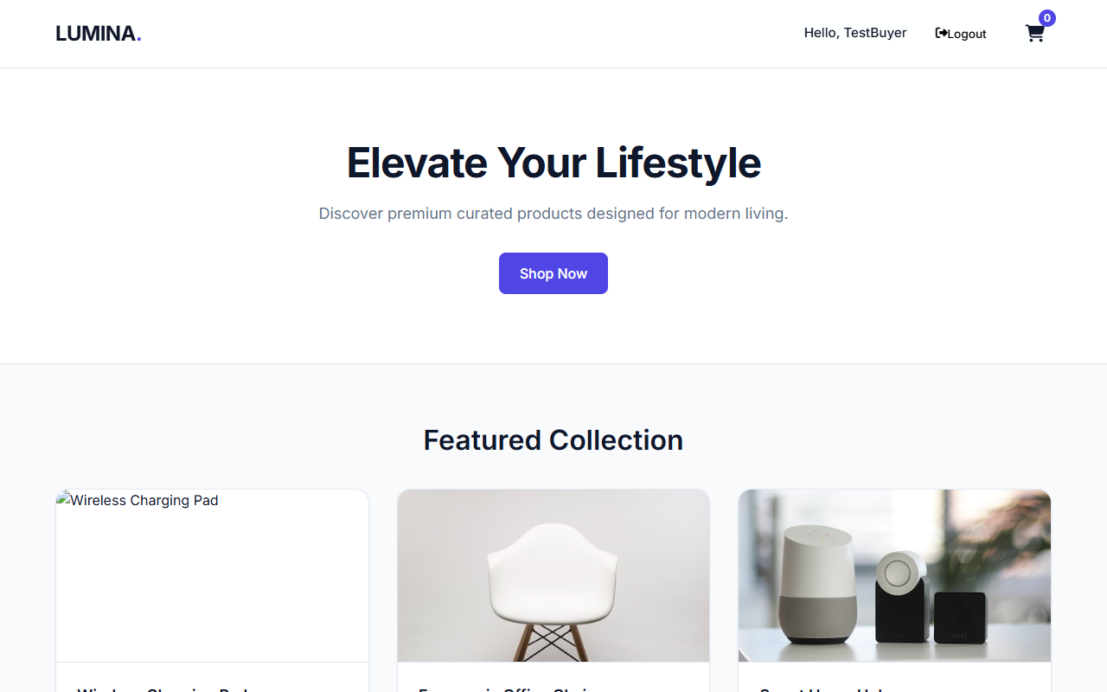
IMPLEMENTATION SCREENSHOTS
1
2
3
4
5
6
7
8
9

Slide 11
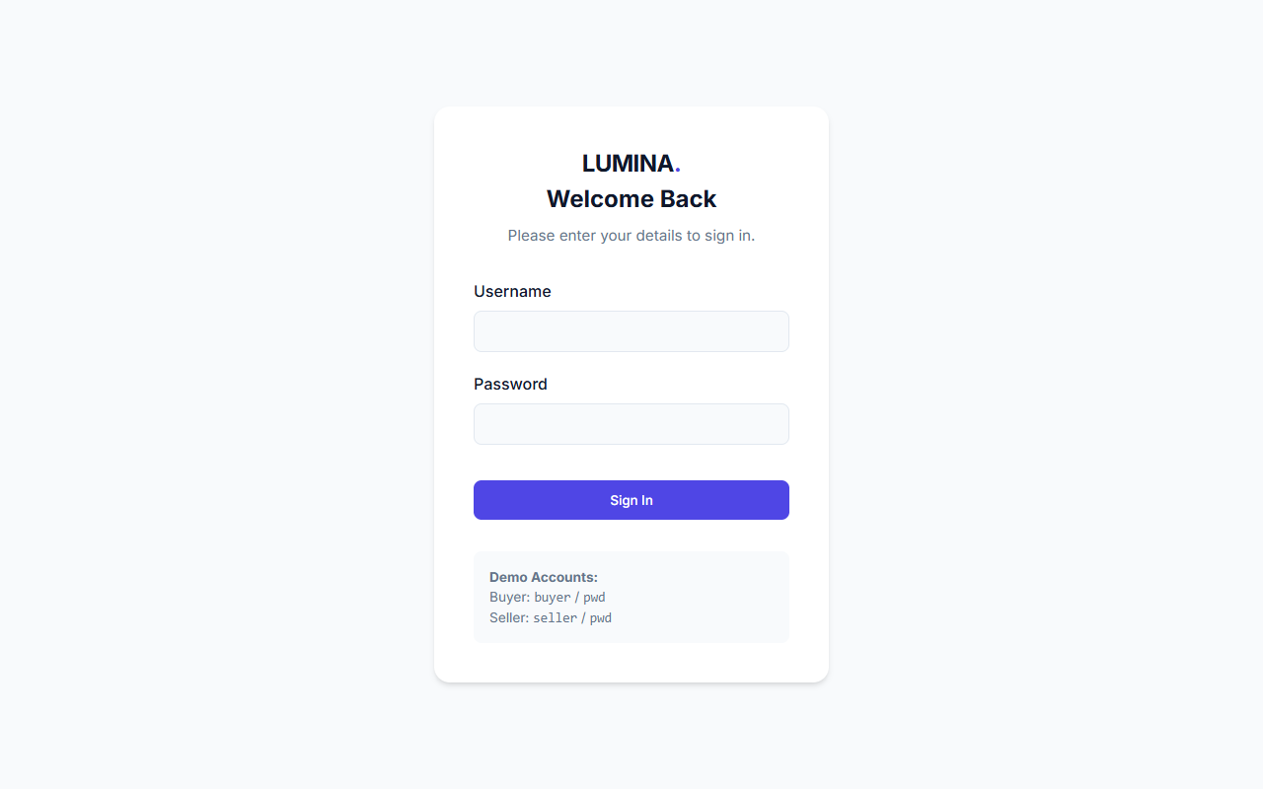
IMPLEMENTATION SCREENSHOTS
1
2
3
4
5
6
7
8(A)
9

Slide 12
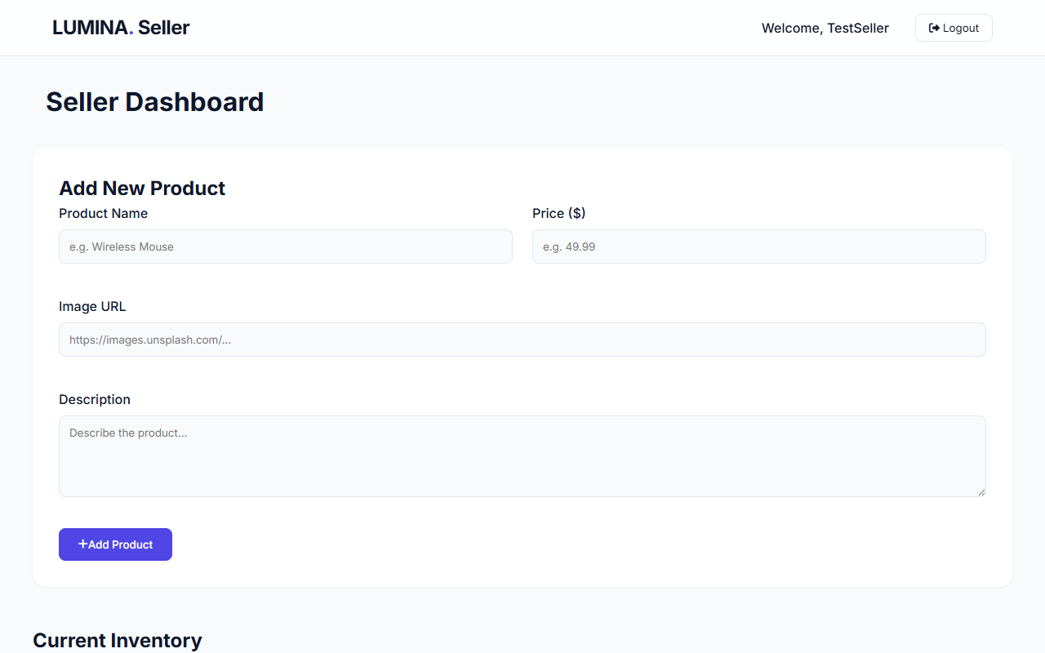
IMPLEMENTATION SCREENSHOTS
1
2
3
4
5
6
7
8(B)
9

Slide 13
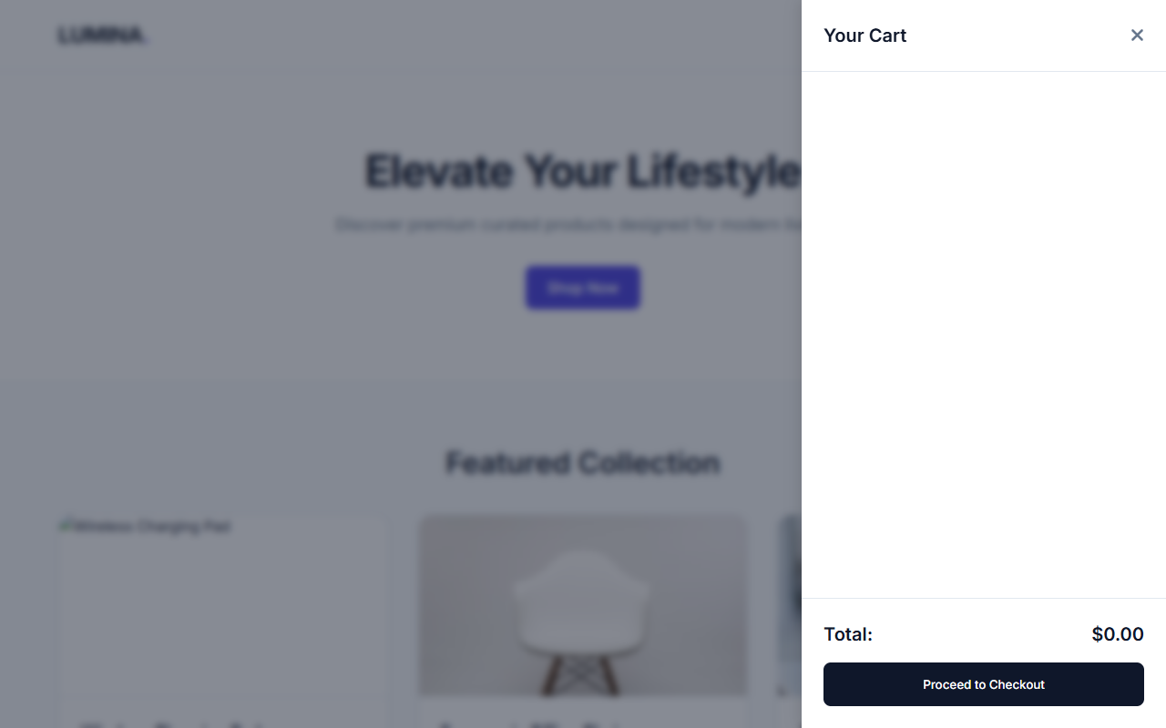
IMPLEMENTATION SCREENSHOTS
1
2
3
4
5
6
7
8(C)
9

Slide 14
.
ADVANTAGES & LIMITATIONS
Advantages:
Provides a responsive design for all devices (mobile, tablet, desktop).
Supports scalability for future enhancements.
Improves user experience and convenience.
Helps businesses improve sales and conversion rates.
Easy to implement using modern web technologies (React, JS, etc.).
Limitations:
Dependency on browser storage (localStorage/sessionStorage).
Limited data storage capacity in client-side storage.
Security risks if sensitive data is stored on the client side.
Performance issues with large data handling.
Browser compatibility issues in older versions.
1
2
3
4
5
6
7
8
9

Slide 15
Thank you

